Slide 1

Pygame Project
How to create your own game in python.
Notes:
General Welcome
Ask for python experience?

Slide 2
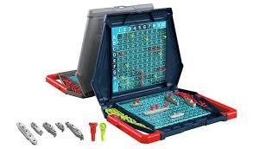
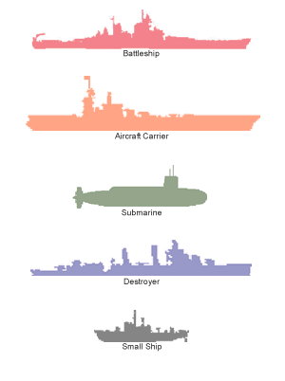
Our game is Battleships
Notes:
Make sure everyone knows what the game is.

Slide 3
In this session:
Discussing the game.
Creating our own module including
The player
Ships
The board
We will be using OOP programming techniques.
In addition, we will also cover the following libraries:
Json
Notes:
For the next few slides,
General discussion on the class to implement (3-5 min)
Have people start their own implementation (10 min)
Showcase my implementation (5-10 min)

Slide 4
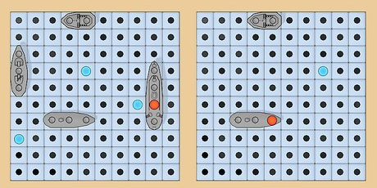
Ships
We need to first design a ship.
What does a ship have?
Shape
Rotation
Position
We also need to keep track of how many times it has been hit, and an easy way to get which grid cells it takes up
How should we store the ship’s data?
In a file?
Hard code it?

Slide 5
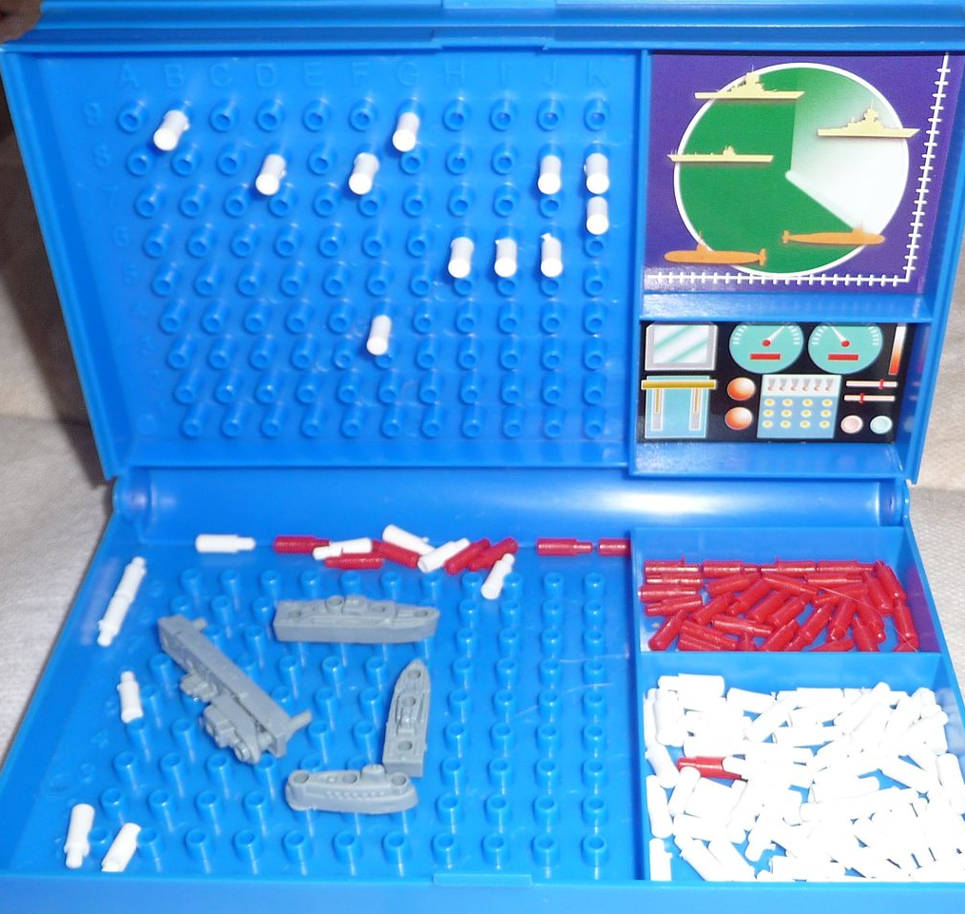
The Board
Each player has 2 boards. One for themselves to place ships, one for the other player to place hits and misses.
We can combine these into one board for each player that stores both the opponents shots and your own ships.
Therefore each board needs to store ships and markers, and be able to add/remove them easily.

Slide 6
The players
The player does not need to store much; you only need to store a board and a unique identifier such as a name.
However, the player will need a way to use the board.
Currently with no UI, the player should be able to:
add ships
move ships
view info on the ships
view the board
Any shooting will require a global Game object to communicate between players. (Next Session)

Slide 7
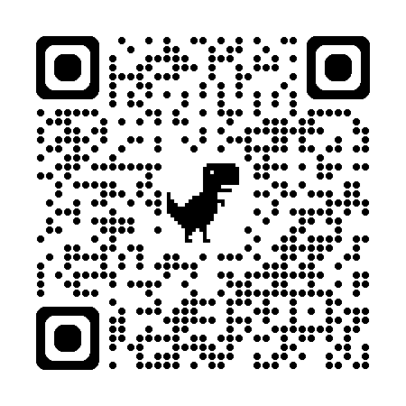
Extra Information & Next Session
You can download my implementation through our Github (QR code).
Session 2:
Introduction to pygame.
Session 3:
Full Implementation
Reading Week
Session 4:
Overview

Slide 8
Thank you !

